Slide 1

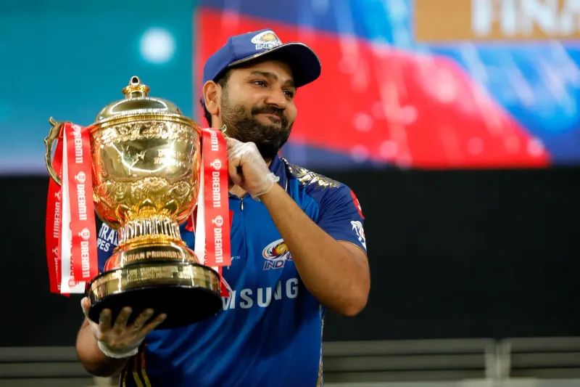

Internshala Titans
Auction strategy for new IPL team Internshala Titans franchise by analyzing past IPL data from the first season to the 13th season which was held in 2020

Slide 2

Table Of Content
01
04
Bidding On Batters
Bidding On WicketKeeprs
Data and chart on Batsmans that have best Strike rate,Average and hard hitting ability
Data and chart on Players that have best Strike rate,Average and stumpping ability
02
05
Bidding On Bowlers
Data and chart on Bowlers that have best Strike rate,Economy and Wicket taking ability
Aditional Questions
03
Bidding On All-rounders
Data and chart on Players that have best Strike rate on bowling and batting both

Slide 3

Bidding On Batters
Aggressive batsmen(Batter with High Strike Rate)
SELECT batsman,
COUNT(batsman) AS "bowl_faced",
SUM(batsman_runs) AS "total_run_scored",
ROUND(((SUM(batsman_runs)*1.0)/COUNT(batsman))*100,2) AS "strike_rate"
FROM ipl_balls GROUP BY batsman
HAVING COUNT(batsman)>500
ORDER BY "strike_rate" DESC
LIMIT 10;

Slide 4
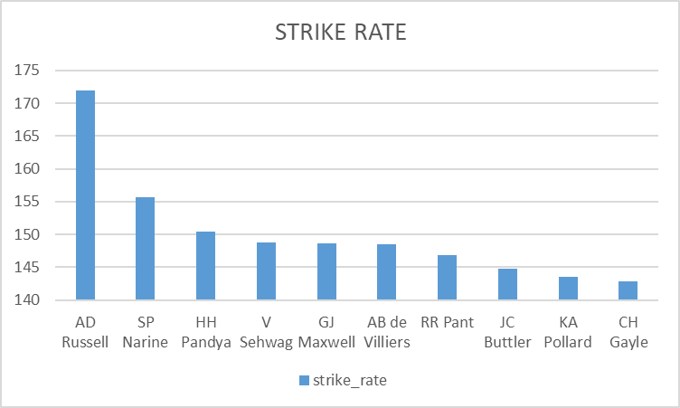
Aggressive batsmen(Batter with High Strike Rate)
Batsman | Ball Faced | Total Run Scored | Strike Rate
AD Russell | 882 | 1517 | 172
SP Narine | 573 | 892 | 155.67
HH Pandya | 897 | 1349 | 150.39
V Sehwag | 1833 | 2728 | 148.83
GJ Maxwell | 1013 | 1505 | 148.57
AB de Villiers | 3264 | 4849 | 148.56
RR Pant | 1416 | 2079 | 146.82
JC Buttler | 1184 | 1714 | 144.76
KA Pollard | 2107 | 3023 | 143.47
CH Gayle | 3342 | 4772 | 142.79

Slide 5
Anchor batsmen(Batter with good average)
SELECT tr.batsman,
tr.run,
o.match AS Total_out,
round(((tr.run*1.0)/o.match),2) AS Average,
s.season AS "Season Played"
FROM (SELECT batsman,
SUM(batsman_runs) AS Run
FROM ipl_balls GROUP BY batsman) as tr
INNER JOIN(SELECT DISTINCT player_dismissed,
COUNT(DISTINCT id) AS match
FROM ipl_balls
WHERE player_dismissed != 'NA'
GROUP BY player_dismissed) AS o
ON tr.batsman=o.player_dismissed
INNER JOIN (SELECT ib.batsman,
COUNT(DISTINCT DATE_PART('year', im.date)) AS Season
FROM ipl_balls AS ib
JOIN ipl_matches AS im
ON ib.id=im.id
GROUP BY batsman) AS s
ON tr.batsman=s.batsman
WHERE s.season>2 AND tr.run>500
ORDER BY Average DESC
LIMIT 10

Slide 6
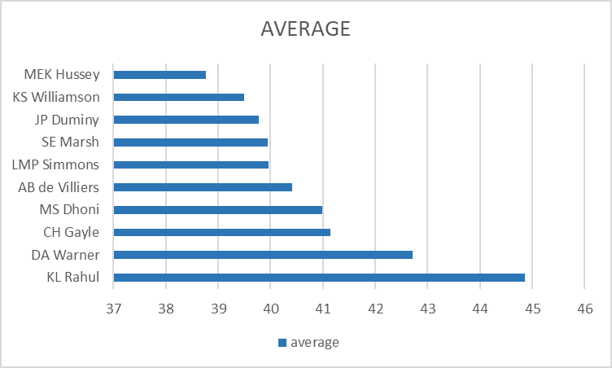
Anchor batsmen(Batter with good average)
Batsman | run | total_out | average | Season Played
KL Rahul | 2647 | 59 | 44.86 | 7
DA Warner | 5254 | 123 | 42.72 | 11
CH Gayle | 4772 | 116 | 41.14 | 12
MS Dhoni | 4632 | 113 | 40.99 | 13
AB de Villiers | 4849 | 120 | 40.41 | 13
LMP Simmons | 1079 | 27 | 39.96 | 4
SE Marsh | 2477 | 62 | 39.95 | 9
JP Duminy | 2029 | 51 | 39.78 | 8
KS Williamson | 1619 | 41 | 39.49 | 6
MEK Hussey | 1977 | 51 | 38.76 | 7

Slide 7
Hard hitter batsmen(Batter with most boundaries)
SELECT DISTINCT ib.batsman,
s.season AS season_played, m.match AS match,
b.ovar_boundaries AS sixes,
ROUND((b.ovar_boundaries*1.0/m.match),2) as "six_per_match",
a.boundaries AS fours,
ROUND((a.boundaries*1.0/m.match),2) as four_per_match,
(ROUND((b.ovar_boundaries*1.0/m.match),2)+ROUND((a.boundaries*1.0/m.match),2))/2 AS avg_boundary
FROM ipl_balls AS ib
JOIN (SELECT batsman, COUNT(batsman_runs) AS boundaries
FROM ipl_balls WHERE batsman_runs=4
GROUP BY batsman ) AS a
ON ib.batsman=a.batsman
JOIN (SELECT batsman, COUNT(batsman_runs) AS ovar_boundaries
FROM ipl_balls WHERE batsman_runs=6
GROUP BY batsman ) AS b
ON ib.batsman=b.batsman
JOIN (SELECT ib.batsman, COUNT(DISTINCT DATE_PART('year', im.date)) AS Season
FROM ipl_balls AS ib
JOIN ipl_matches AS im ON ib.id=im.id
GROUP BY batsman) AS s
ON ib.batsman=s.batsman
JOIN(SELECT DISTINCT batsman, COUNT(distinct id) AS match
FROM ipl_balls
GROUP BY batsman
ORDER BY match DESC) AS m
ON ib.batsman=m.batsman
WHERE s.season>2
ORDER BY avg_boundary DESC LIMIT 10

Slide 8
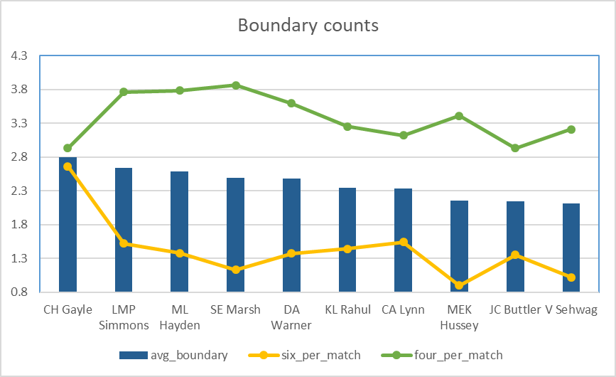
Hard hitter batsmen(Batter with most boundaries)
batsman | season_played | match | sixes | six_per_match | fours | four_per_match | avg_ boundary
CH Gayle | 12 | 131 | 349 | 2.66 | 384 | 2.93 | 2.795
LMP Simmons | 4 | 29 | 44 | 1.52 | 109 | 3.76 | 2.64
ML Hayden | 3 | 32 | 44 | 1.38 | 121 | 3.78 | 2.58
SE Marsh | 9 | 69 | 78 | 1.13 | 266 | 3.86 | 2.495
DA Warner | 11 | 142 | 195 | 1.37 | 510 | 3.59 | 2.48
KL Rahul | 7 | 72 | 104 | 1.44 | 234 | 3.25 | 2.345
CA Lynn | 6 | 41 | 63 | 1.54 | 128 | 3.12 | 2.33
MEK Hussey | 7 | 58 | 52 | 0.9 | 198 | 3.41 | 2.155
JC Buttler | 5 | 57 | 77 | 1.35 | 167 | 2.93 | 2.14
V Sehwag | 8 | 104 | 106 | 1.02 | 334 | 3.21 | 2.115

Slide 9
Bidding On Bowlers
Economical bowlers(bowlers with good economy)
SELECT DISTINCT bowler,
COUNT(bowler) AS balls,
(COUNT(bowler)/6) || '.' || (COUNT(bowler)%6) AS Over,
SUM(total_runs) AS run,
ROUND(SUM(total_runs)/(COUNT(bowler)/6.0),2) AS economy
FROM ipl_balls
GROUP BY DISTINCT bowler
HAVING COUNT(bowler)>500
ORDER BY economy
LIMIT 10;

Slide 10
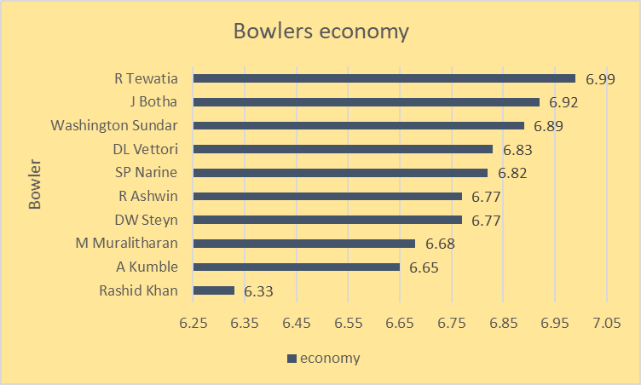
ECONOMICAL BOWLERS(BOWLERS WITH GOOD ECONOMY)
bowler | balls | over | run | economy
Rashid Khan | 1490 | 248.2 | 1573 | 6.33
A Kumble | 983 | 163.5 | 1089 | 6.65
M Muralitharan | 1577 | 262.5 | 1755 | 6.68
DW Steyn | 2276 | 379.2 | 2568 | 6.77
R Ashwin | 3327 | 554.3 | 3756 | 6.77
SP Narine | 2824 | 470.4 | 3208 | 6.82
DL Vettori | 785 | 130.5 | 894 | 6.83
Washington Sundar | 660 | 110 | 758 | 6.89
J Botha | 709 | 118.1 | 818 | 6.92
R Tewatia | 587 | 97.5 | 684 | 6.99

Slide 11
WICKET TAKING BOWLERS(BOWLERS WITH THE BEST STRIKE RATE)
SELECT DISTINCT ib.bowler, COUNT(ib.bowler) AS balls,
b.wickets,
ROUND(COUNT(ib.bowler)*1.0/b.wickets,2)AS strike_rate
FROM ipl_balls AS ib
LEFT JOIN(SELECT bowler, COUNT(bowler) AS wickets
FROM ipl_balls
WHERE is_wicket='true' AND dismissal_kind != 'run out'
GROUP BY bowler) AS b
ON ib.bowler=b.bowler
GROUP BY DISTINCT ib.bowler , b.wickets
HAVING COUNT(ib.bowler)>500
ORDER BY strike_rate
LIMIT 10

Slide 12
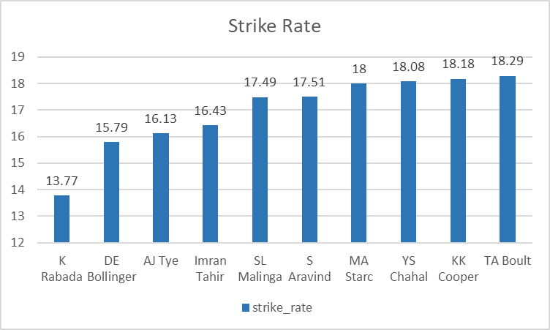
WICKET TAKING BOWLERS(BOWLERS WITH THE BEST STRIKE RATE)
bowler | balls | wickets | strike_rate
K Rabada | 840 | 61 | 13.77
DE Bollinger | 600 | 38 | 15.79
AJ Tye | 645 | 40 | 16.13
Imran Tahir | 1314 | 80 | 16.43
SL Malinga | 2974 | 170 | 17.49
S Aravind | 788 | 45 | 17.51
MA Starc | 612 | 34 | 18
YS Chahal | 2188 | 121 | 18.08
KK Cooper | 600 | 33 | 18.18
TA Boult | 1152 | 63 | 18.29

Slide 13
ALL ROUNDERS
(ALL_ROUNDERS WITH THE BEST BATTING AS WELL AS BOWLING STRIKE RATE)
SELECT * FROM
(SELECT bl.bowler,
bl.balls,
bl.strike_rate AS bowling_strike_rate,
bt.bowl_faced,
bt.strike_rate AS batting_strike_rate,
ROW_NUMBER() OVER(ORDER BY bt.strike_rate DESC) AS batting_rank,
ROW_NUMBER() OVER(ORDER BY bl.strike_rate ASC) AS bowling_rank,
round(1.0*(ROW_NUMBER() OVER(ORDER BY bt.strike_rate DESC)
+
ROW_NUMBER() OVER(ORDER BY bl.strike_rate ASC))/2,2)
as avg_rank
FROM wicket_taker AS bl
JOIN(SELECT batsman,strike_rate, bowl_faced
FROM strike_rate
WHERE bowl_faced>500) as bt
ON bt.batsman=bl.bowler
WHERE bl.balls>300) AS a
ORDER BY avg_rank
LIMIT 10

Slide 14
ALL ROUNDERS
(ALL_ROUNDERS WITH THE BEST BATTING AS WELL AS BOWLING STRIKE RATE)
Player | balls | bowling_strike_rate | bowl_faced | batting_strike_rate | batting_rank | bowling_rank | avg_rank
AD Russell | 1186 | 19.44 | 882 | 172 | 1 | 2 | 1.5
HH Pandya | 914 | 21.76 | 897 | 150.39 | 3 | 7 | 5
SP Narine | 2824 | 22.24 | 573 | 155.67 | 2 | 8 | 5
JA Morkel | 1807 | 21.26 | 711 | 136.99 | 9 | 5 | 7
MP Stoinis | 562 | 20.07 | 623 | 132.42 | 13 | 3 | 8
KA Pollard | 1414 | 23.57 | 2107 | 143.47 | 5 | 14 | 9.5
DR Smith | 557 | 21.42 | 1803 | 132.28 | 14 | 6 | 10
SR Watson | 2137 | 23.23 | 2888 | 134.14 | 10 | 13 | 11.5
ST Jayasuriya | 301 | 23.15 | 573 | 134.03 | 11 | 12 | 11.5
DJ Bravo | 2846 | 18.6 | 1199 | 124.27 | 22 | 1 | 11.5

Slide 15
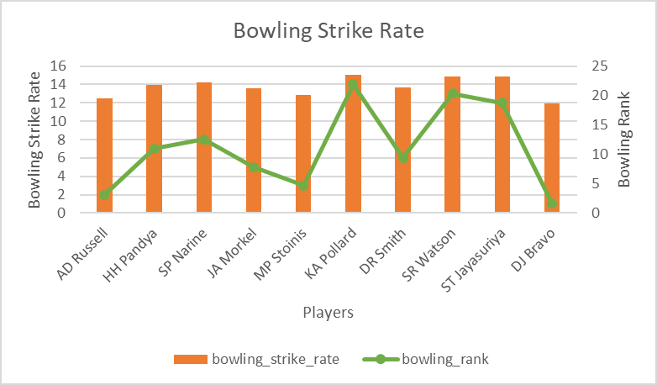
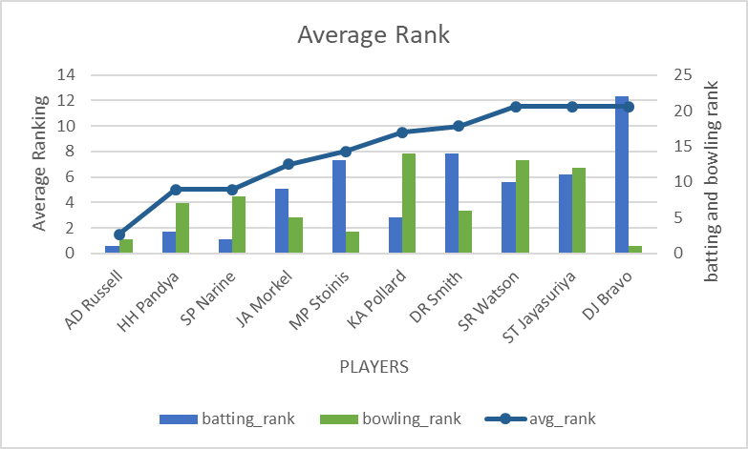
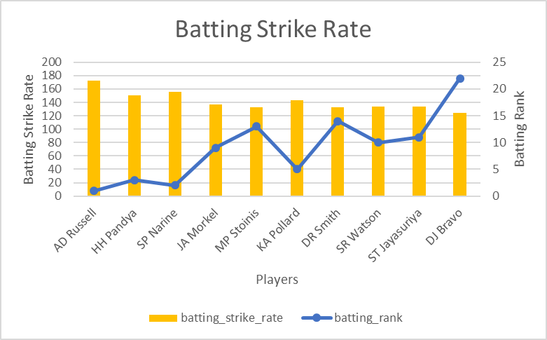
ALL ROUNDERS
(ALL_ROUNDERS WITH THE BEST BATTING AS WELL AS BOWLING STRIKE RATE)

Slide 16
WICKETKEEPER
SELECT s.fielder,
tr.average,
COUNT(s.fielder) AS stumped_count,
c.caught_count
FROM ipl_balls AS s
LEFT JOIN(SELECT fielder,
COUNT(fielder) AS caught_count
FROM ipl_balls
WHERE dismissal_kind='caught'
GROUP BY fielder) AS c
ON s.fielder=c.fielder
JOIN (SELECT * FROM good_avg WHERE run>500)AS tr
ON s.fielder=tr.batsman
JOIN(SELECT DISTINCT batsman, COUNT(distinct id) AS match
FROM ipl_balls
GROUP BY batsman
ORDER BY match DESC) as m
ON s.fielder=m.batsman
WHERE dismissal_kind='stumped'
GROUP BY s.fielder,c.caught_count,tr.run,tr.average
ORDER BY tr.average DESC,stumped_count DESC
LIMIT 10

Slide 17
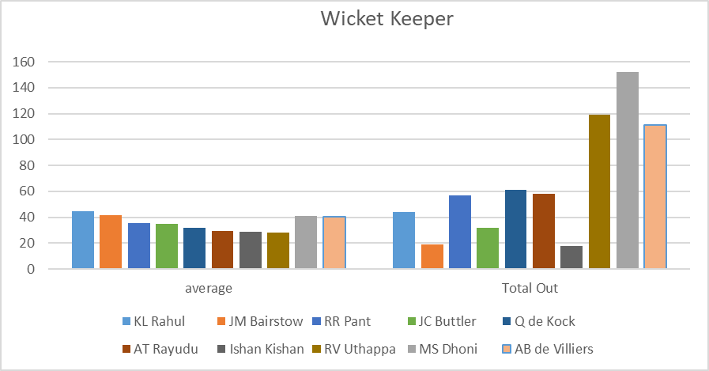
WICKETKEEPER
Wicketkeeper | average | stumped_count | caught_count | Total Out
KL Rahul | 44.86 | 5 | 39 | 44
JM Bairstow | 41.58 | 3 | 16 | 19
MS Dhoni | 40.99 | 39 | 113 | 152
AB de Villiers | 40.41 | 8 | 103 | 111
RR Pant | 35.24 | 11 | 46 | 57
JC Buttler | 34.98 | 1 | 31 | 32
Q de Kock | 31.6 | 12 | 49 | 61
AT Rayudu | 29.51 | 2 | 56 | 58
Ishan Kishan | 28.83 | 2 | 16 | 18
RV Uthappa | 27.92 | 32 | 87 | 119

Slide 18
Additional Questions
The count of cities that have hosted an IPL match
SELECT DISTINCT city FROM ipl_matches

Slide 19
2. Create table deliveries_v02 with all the columns of the table ‘deliveries’ and an additional column ball_result containing values boundary, dot or other depending on the total_run (boundary for >= 4, dot for 0 and other for any other number)
CREATE TABLE deliveries_v02 AS
SELECT *, CASE
WHEN total_runs >3 THEN 'boundary'
WHEN total_runs=0 THEN 'dot'
ELSE 'other'
END AS ball_result
FROM ipl_balls

Slide 20
3.Write a query to fetch the total number of boundaries and dot balls from the deliveries_v02 table.
SELECT DISTINCT ball_result,
COUNT(ball_result) AS boundaries_total
FROM deliveries_v02
GROUP BY ball_result
HAVING ball_result!='other'

Slide 21
4. Write a query to fetch the total number of boundaries scored by each team from the deliveries_v02 table and order it in descending order of the number of boundaries scored.
SELECT DISTINCT batting_team,
COUNT(ball_result) AS boundaries_scored
FROM deliveries_v02
GROUP BY batting_team,ball_result
HAVING ball_result='boundary'
ORDER BY boundaries_scored desc

Slide 22
5. Write a query to fetch the total number of dot balls bowled by each team and order it in descending order of the total number of dot balls bowled.
SELECT DISTINCT bowling_team,
COUNT(ball_result) AS dot_bowl
FROM deliveries_v02
GROUP BY bowling_team,ball_result
HAVING ball_result='dot'
ORDER BY dot_bowl desc

Slide 23
6. Write a query to fetch the total number of dismissals by dismissal kinds where dismissal kind is not NA
SELECT DISTINCT dismissal_kind,
COUNT(dismissal_kind)
FROM ipl_balls
GROUP BY dismissal_kind
HAVING dismissal_kind !='NA'

Slide 24
7. Write a query to get the top 5 bowlers who conceded maximum extra runs from the deliveries table
SELECT DISTINCT bowler,
sum(extra_runs) AS extra_run_tot
FROM ipl_balls
GROUP BY bowler
ORDER BY extra_run_tot DESC
LIMIT 5;

Slide 25
8. Write a query to create a table named deliveries_v03 with all the columns of deliveries_v02 table and two additional column (named venue and match_date) of venue and date from table matches
CREATE TABLE deliveries_v03 AS
SELECT a.*,b.city,b.date
FROM deliveries_v02 AS a
JOIN ipl_matches AS b
ON a.id=b.id

Slide 26
9. Write a query to fetch the total runs scored for each venue and order it in the descending order of total runs scored.
SELECT im.venue,
SUM(ib.total_runs) AS total_run
FROM ipl_matches AS im
JOIN ipl_balls AS ib
ON im.id=ib.id
GROUP BY im.venue
ORDER BY total_run DESC

Slide 27
10. Write a query to fetch the year-wise total runs scored at Eden Gardens and order it in the descending order of total runs scored
SELECT im.venue,
EXTRACT(year from im.date) as Year,
SUM(ib.total_runs) AS total_run
FROM ipl_matches AS im
JOIN ipl_balls AS ib
ON im.id=ib.id
GROUP BY im.venue,Year
HAVING im.venue='Eden Gardens'
ORDER BY total_run DESC

Slide 28
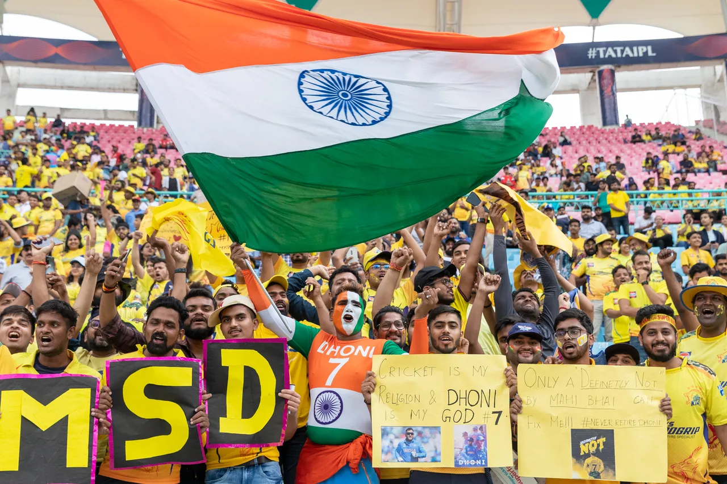
Thank You!
Presented By Souvik hakraborty
Data Science PGC, March 2023

